Slide 1
Post-Error Slowing in Mice
A project by PEZ Group - Ogi Pod
Nitika, Prince, Samantha, Sonja

Slide 2
00
Introduction

Slide 3
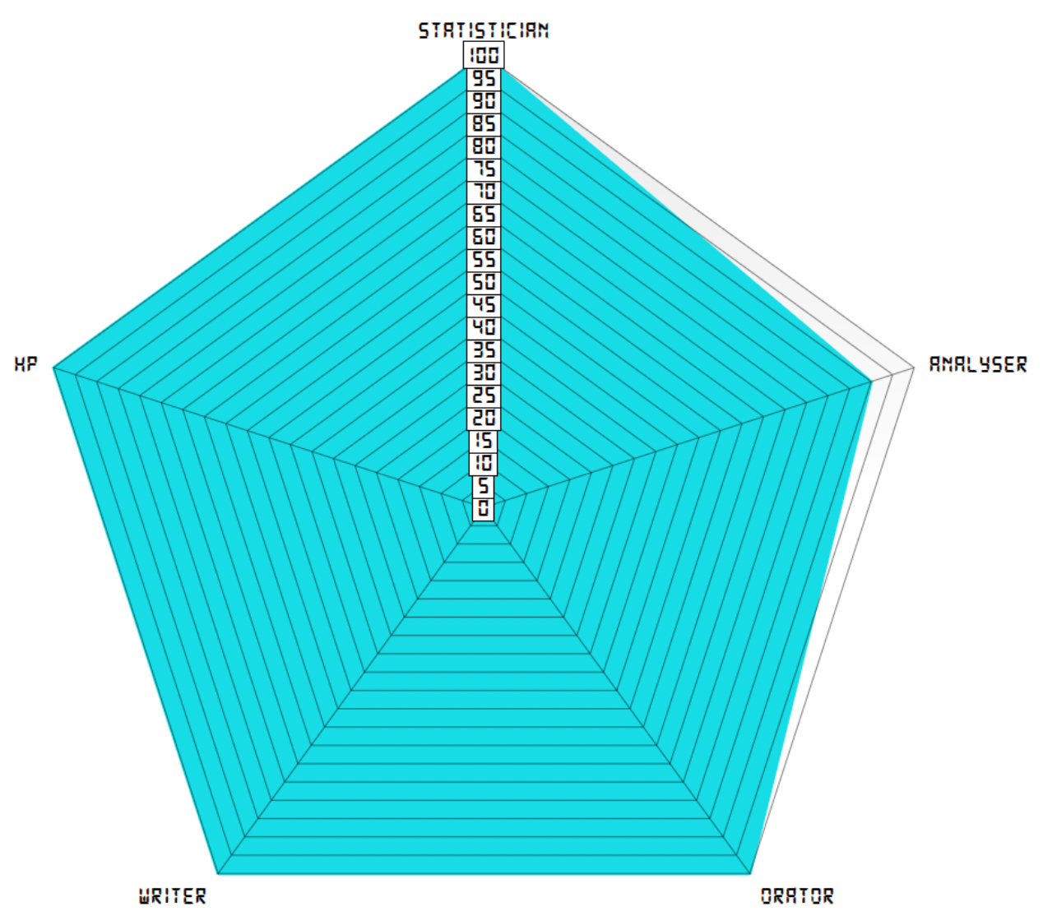
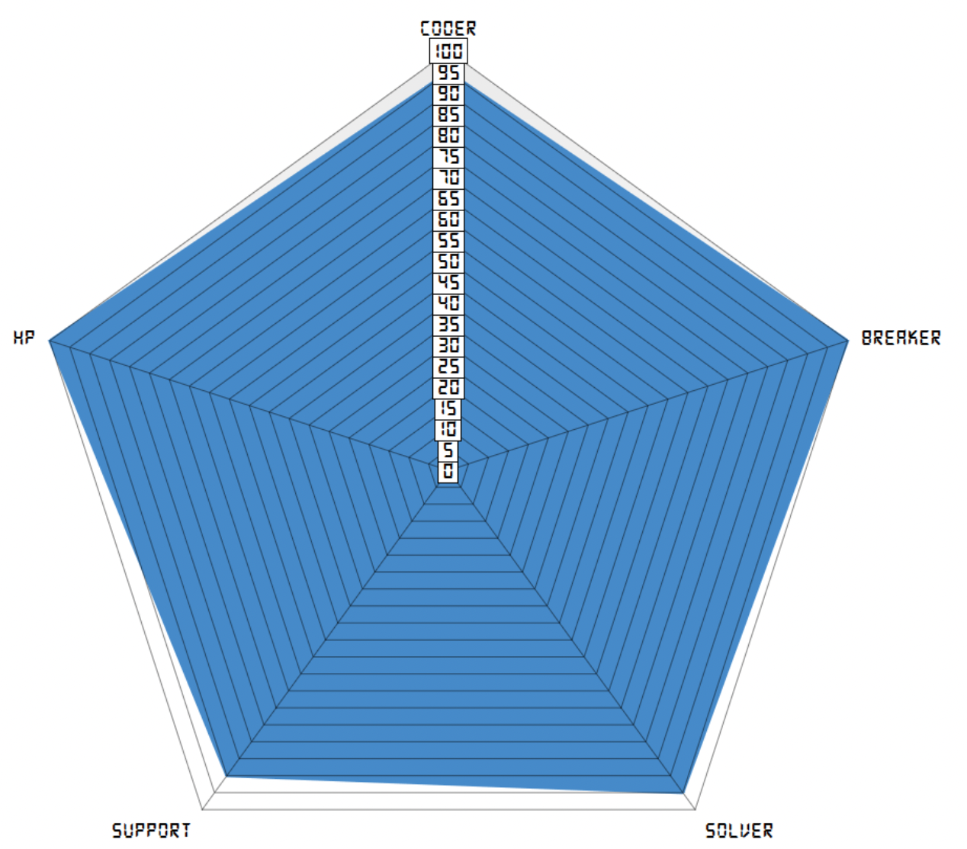


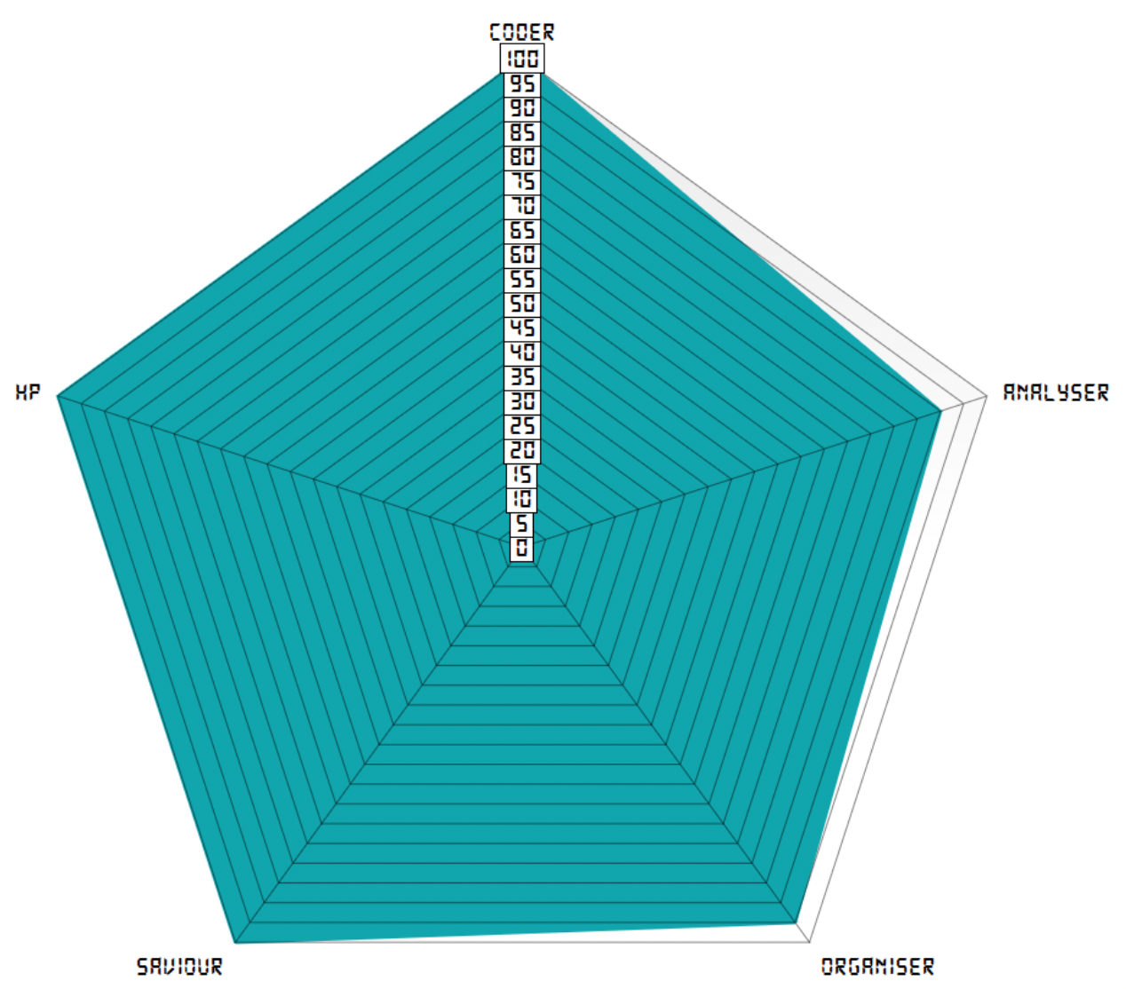
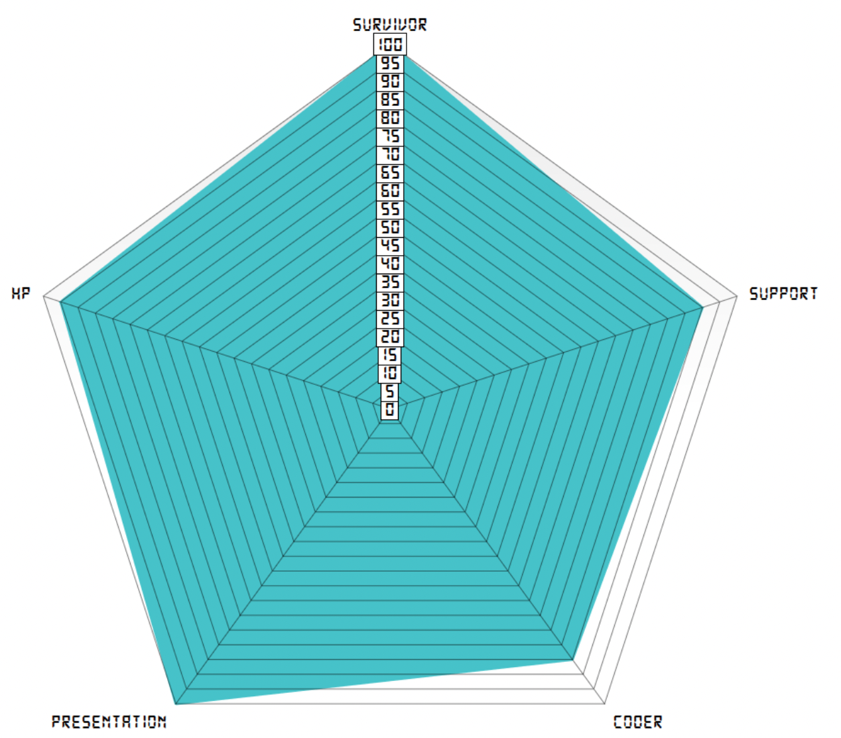


Team Introduction

Slide 4
01
Primary Finding
There may be evidence for post-error slowing in mice.

Slide 5
Background
Decision making as accumulation of noisy evidence
Adapting to errors crucial for learning and survival
Choice history influences updating of accumulation process and decision making strategy
Post-error slowing (PES): reduced response time after an erroneous response
Reliably replicated in humans
Does it exist in mice?

Slide 6
The data & our questions
Behavioral data by International Brain Laboratory (IBL)
2 alternatives, forced-choice perceptual decision task in mice
Different response times observed in animals
Are differences in response time associated with prior incorrect response, or other factors, e.g., contrast level, session phase?

Slide 7
02
Hypotheses
Incorrect prior response leads to increased response time at subsequent trial.
Choice history can predict response time in subsequent trial in new data.

Slide 8
03
Methods

Slide 9
Step 1: Pre-process Data
Calculate the response duration, delay of stimulus onset, stimulus location, stimulus contrast and session phase
Normalize data
Step 2: T-Test
Run a standard t-test in order to compare response duration after correct and after incorrect trial
Mercury is the closest planet to the Sun and the smallest one in the Solar System—it’s only a bit larger than the Moon. The planet’s name has nothing to do with the liquid
Notes:
Response_duration (['trial_response_time'] - pd_data_all['trial_stim_on_time']
Stimulus_delay l['trial_stim_on_time'] - pd_data_all['trial_start_time']
stimulus_location[index] = 2 # 2 IS RIGHT
stimulus_contrast[index] = pd_data_all['trial_stim_contrast_right'][index]
Normalize data by subtracting the mean and dividing by the standard deviation (x - np.nanmean(x)) / (np.nanstd(x)) )
Our t-test had a few assumptions, mainly that each trial was independent of each other. We understand that this is a large assumption to make, since we were using hierarchical data, however it was an assumption made for the sake of simplicity.

Slide 10
Step 3: Train GLM
GLM trained on the Churchland Lab
The best formula was: 'normalized_response_duration ~ normalized_stimulus_delay + C(session_phase) + stimulus_contrast + stimulus_location + trial_feedback_type'
Cross-validation to get a distribution of R_squared
Step 4: Test GLM on all other labs
Test on each of the other labs, minus the Mainen lab, was used as an independent test set
Mercury is the closest planet to the Sun and the smallest one in the Solar System—it’s only a bit larger than the Moon. The planet’s name has nothing to do with the liquid

Slide 11
04
Analysis & Findings

Slide 12
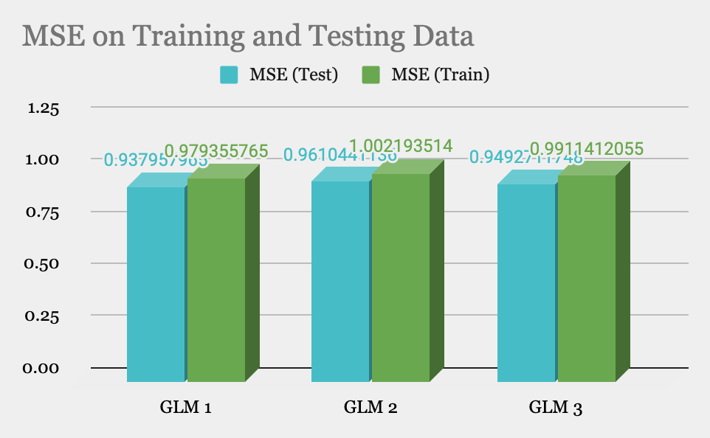
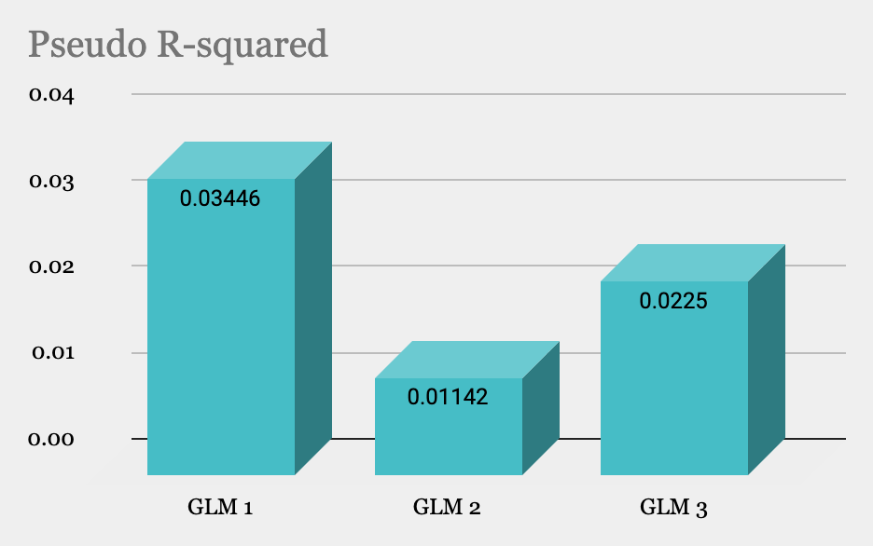
Mean Squared Error and Pseudo R-squared across GLM models

Slide 13
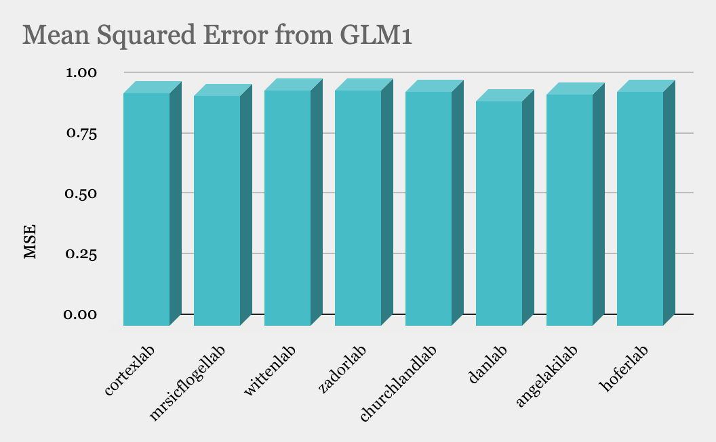
Mean Squared Error on data from all labs

Slide 14
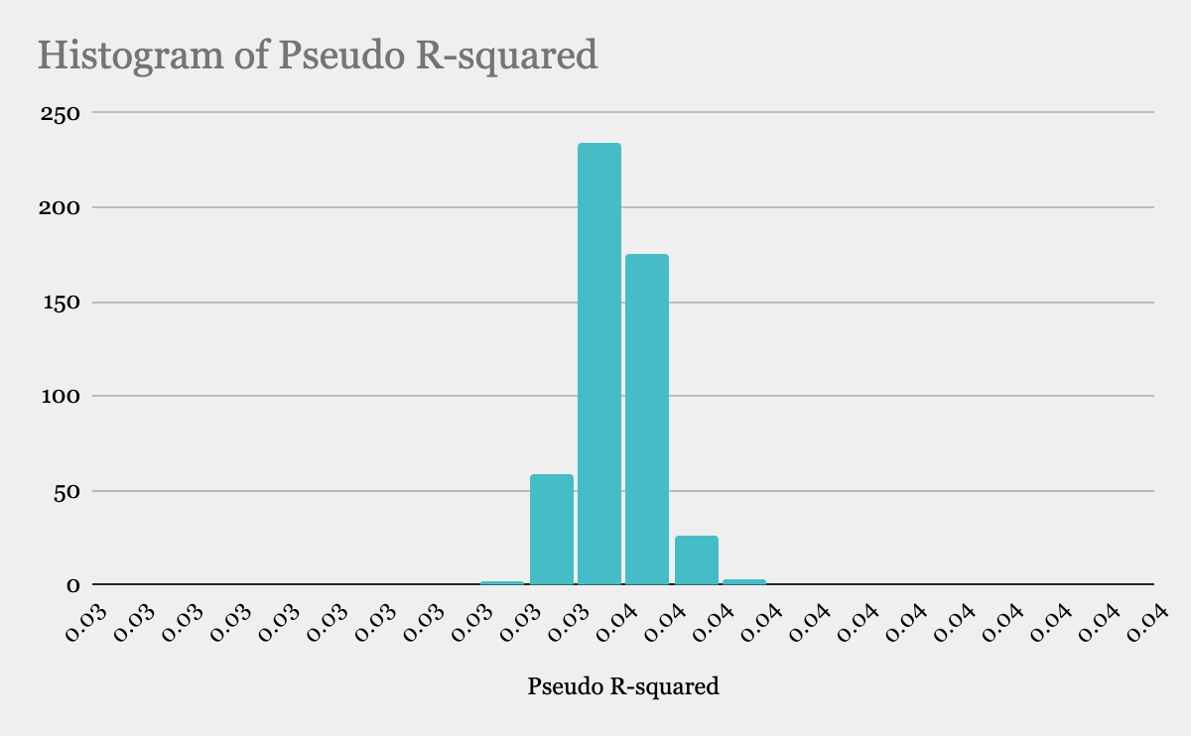
Pseudo R-squared distribution for GLM 1

Slide 15
05
Conclusion & Future direction

Slide 16
Mercury is the closest planet to the Sun and the smallest one in the Solar System—it’s only a bit larger than the Moon. The planet’s name has nothing to do with the liquid
The findings suggest some evidence of post error slowing in the mice
Variables apart from the ones we studied; external variables such as lighting, temperature, or internal variables such as the attention span of mice can be included
Tests can be done to check for a non-linear relationship between the variables

Slide 17
06
Credits

Slide 18

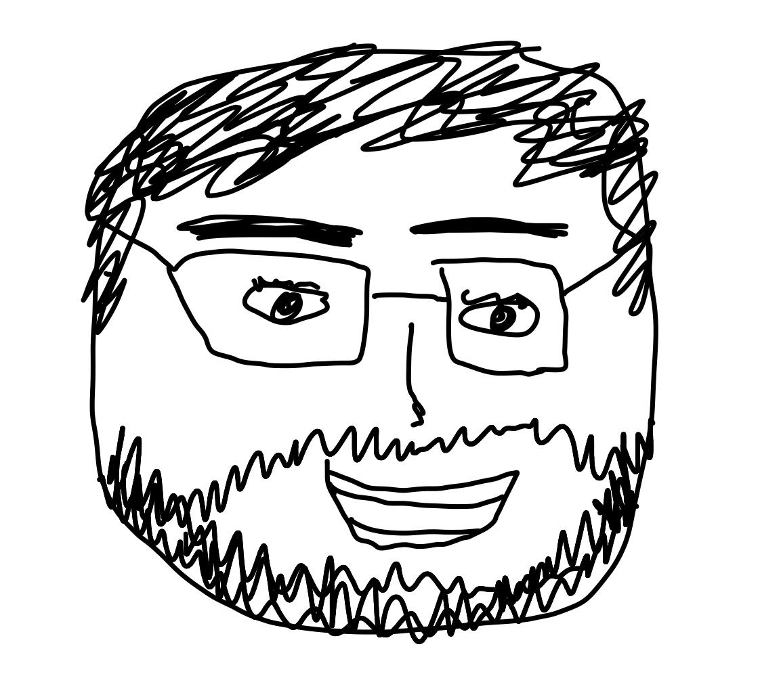
***** RUSLAN ****** (THE BEST!!!!!!!!)🎉🎉🎉
Mercury is the closest planet to the Sun and the smallest one in the Solar System—it’s only a bit larger than the Moon. The planet’s name has nothing to do with the liquid

Slide 19
GeeksForGeeks
Ruslan Klymentiev
Python explanation packages
Ruslan Klymentiev
https://datascientyst.com
https://www.statology.org
Mo Shahdloo
Amol P. Yadav
https://data.internationalbrainlab.org/
Mercury is the closest planet to the Sun and the smallest one in the Solar System—it’s only a bit larger than the Moon. The planet’s name has nothing to do with the liquid

Slide 20
07
Tools / Packages / Softwares

Slide 21
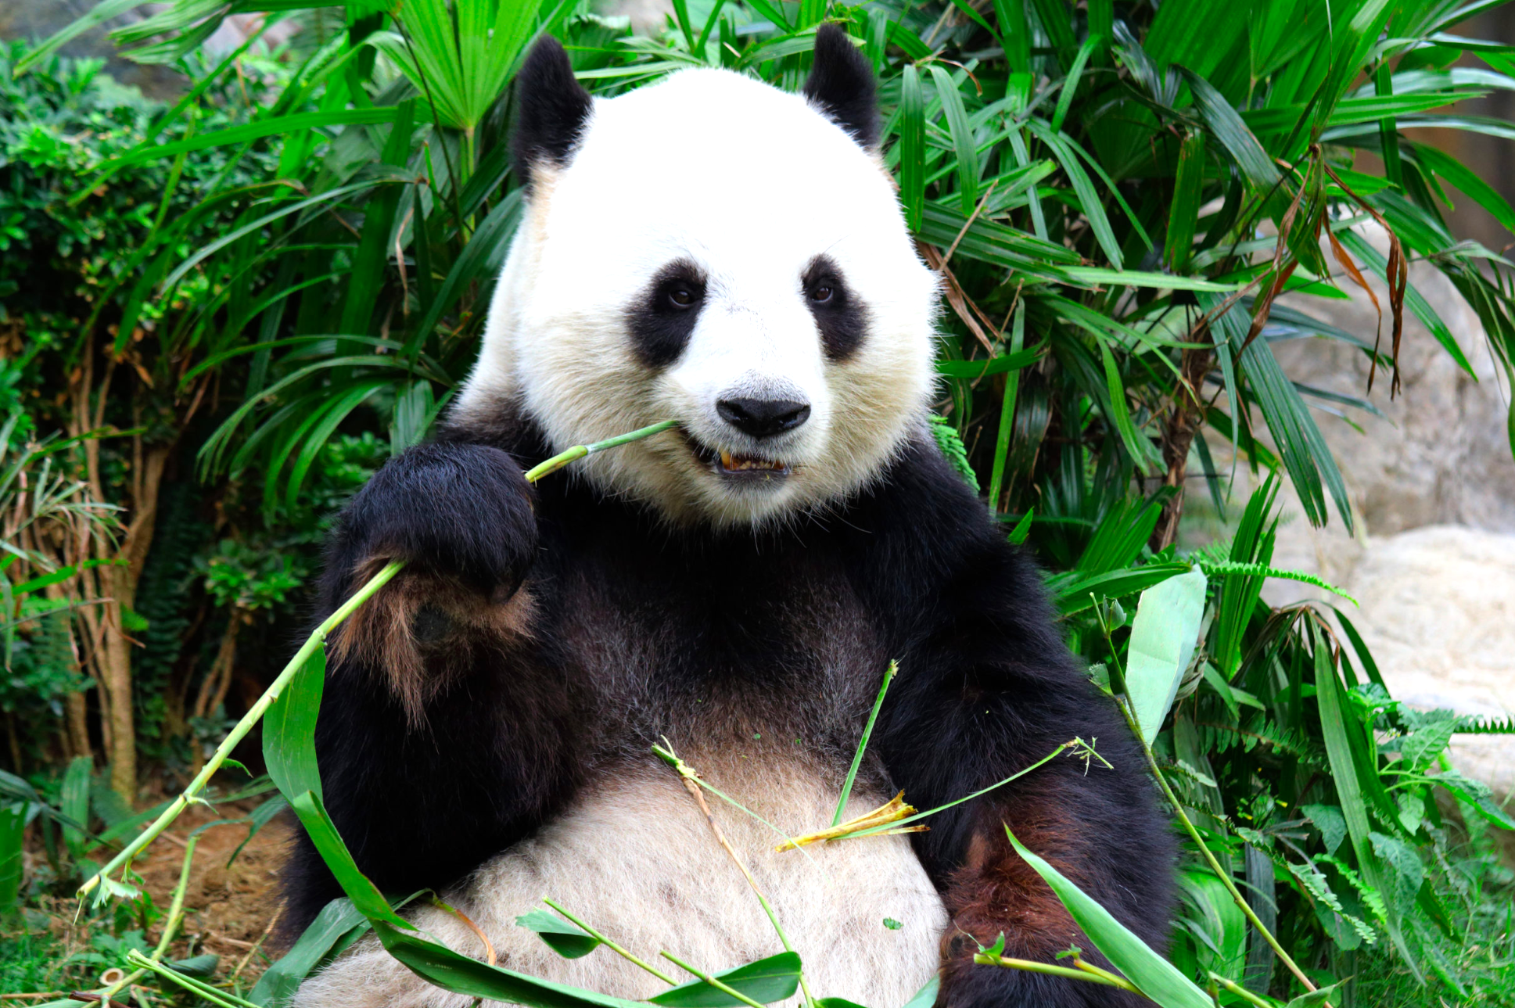
Mercury is the closest planet to the Sun and the smallest one in the Solar System—it’s only a bit larger than the Moon. The planet’s name has nothing to do with the liquid
Google Colab (obviously)
Datajoint dataframe, used by IBL
Pandas dataframe, for easier access to data
Statsmodels.formula.api, which had a glm function
Sklearn.metrics, mean squared error, in order to test the glm fit on general data
Image credits to https://kinderzeitung.kleinezeitung.at/grosse-pandas-voll-verfressen-und-gemuetlich/

Slide 22
—Brian Herbert
“The capacity to learn is a gift; the ability to learn is a skill; the willingness to learn is a choice.”

Slide 23
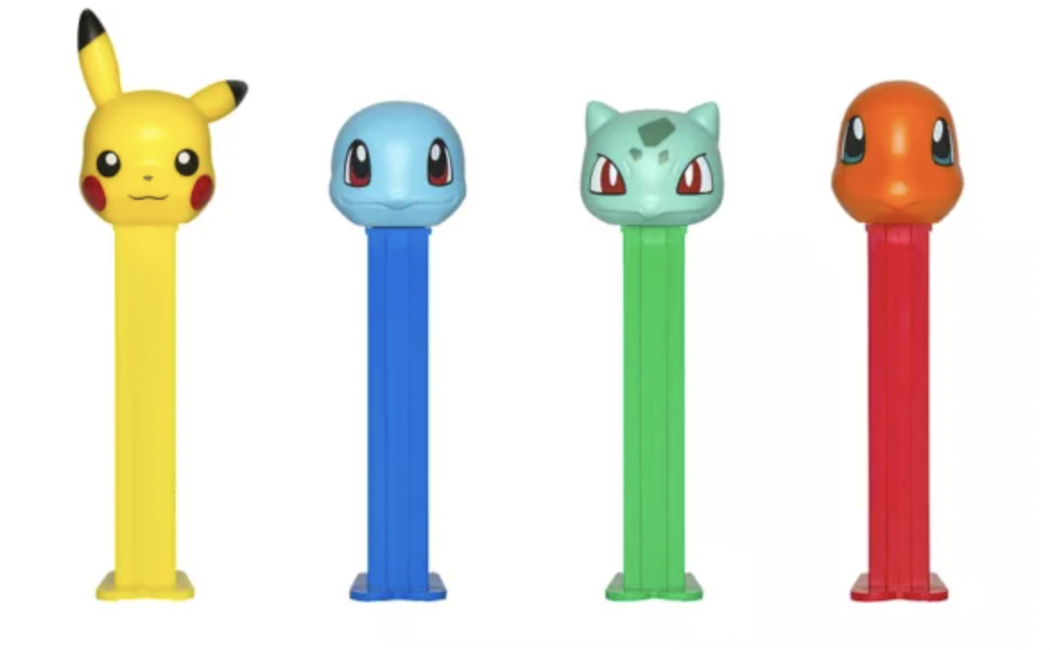
Thank You!

Slide 24
Who’s doing what
Introduction - who we are - everyone
background/ motivation/ description of the dataset - Sonja
Methods - Sam
Analysis of the results (MSE, R-squared, generalised across labs)/ findings/ answer to the research question - Nitika
conclusion/ future directions - Prince
INTRO SLIDE IS MINE. PLS.
Sam - Coder, Organiser, Saviour
Sonja - Statistician, Orator, Writer
Nitika - Survivor, Background Support, PPT maker
Prince -

Slide 25
09
Motivation behind this topic

Slide 26
[here we talk about how the phenomenon of post-error slowing has been observed in mice]
[tbh it would seem a bit redundant, so again, this section is not compulsory]
If we talk about this:
We discuss the order of this slide in this presentation
Else:
We don’t do that here
Mercury is the closest planet to the Sun and the smallest one in the Solar System—it’s only a bit larger than the Moon. The planet’s name has nothing to do with the liquid

Slide 27
Overview
To look for evidence of post-error slowing in mice by analysing and working on the IBL Dataset
This presentation contains the following:
General idea
Problem
Literature review
Description of the dataset used
Project outline
Hypotheses
Findings
Roadblocks countered and defeated
Motivation behind the project topic
Future direction
Tools / packages / softwares used
Credits

Slide 28
02
Problem

Slide 29
Mercury is the closest planet to the Sun and the smallest one in the Solar System—it’s only a bit larger than the Moon. The planet’s name has nothing to do with the liquid
[we write here a brief description of our problem/ the phenomenon we are trying to investigate]
[can take ideas/ reference from the project proposal]

Slide 30
03
Literature Review

Slide 31
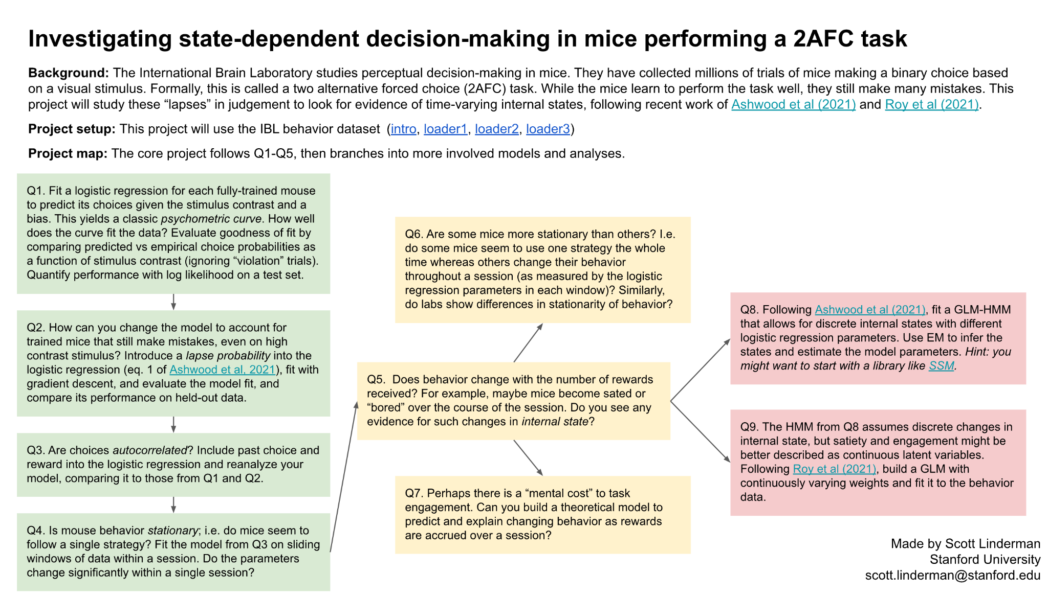
PROJECT TEMPLATE

Slide 32
Mercury is the closest planet to the Sun and the smallest one in the Solar System—it’s only a bit larger than the Moon. The planet’s name has nothing to do with the liquid
[we write here a the literature review on the basis of which we have based our hypotheses; specifically, the project template]
[can take ideas/ reference from the project proposal]
[we talk about the project template first coz that’s where we started]

Slide 33
04
Dataset Used

Slide 34
Mercury is the closest planet to the Sun and the smallest one in the Solar System—it’s only a bit larger than the Moon. The planet’s name has nothing to do with the liquid
[Description of the IBL dataset]
[where, how, what it is]
[data available to us in that dataset]

Slide 35
05
Project Outline

Slide 36
How the events unfolded…
[ we decide the steps we wanna show here as the chain of actions we undertook till the end]

Slide 37
In the trial after an incorrect response is recorded, there will be an increase in response time.
We believe that, given <input variables>, there is a reliable method to predict response times in subsequent trials.
Our <input variable include>:
Response on the previous trial (incorrect/ correct)
Signal contrast in % (100, 75, 50, 25)
Signal position (left/ right)
Delay of stimulus onset
Session phase (early, middle, late)
Mercury is the closest planet to the Sun and the smallest one in the Solar System—it’s only a bit larger than the Moon. The planet’s name has nothing to do with the liquid

Slide 38
08
Roadblocks encountered and defeated

Slide 39
[personally, i feel its a good idea to tell about the challenges faced in the project and how we overcame them]
[it makes one seem less intimidating and more relatable, especially in an academic setting where most of us 99% of the time have no clue wtf is going on]
[but of course, we can do away with this section :) ]
Mercury is the closest planet to the Sun and the smallest one in the Solar System—it’s only a bit larger than the Moon. The planet’s name has nothing to do with the liquid

Slide 40
[some things we could improve on can be included as a future direction]
[example, to see what factors other than the ones we included could be responsible]
[maybe include external variables too, such as lighting, temperature etc]
[or intrinsic factors like attention span of the mouse]
Mercury is the closest planet to the Sun and the smallest one in the Solar System—it’s only a bit larger than the Moon. The planet’s name has nothing to do with the liquid

